Slide 1
Transformers for Medical Image Segmentation
Di Liu

Slide 2
Background
Motivation
Self-attention-based architectures, in particular Transformers ^{[1]}, have become the model of choice in NLP for their computational efficiency and scalability.
However, convolutional architectures remain dominant in CV.
Inspired by the Transformer scaling successes in NLP, multiple works try to apply Transformer or self-attention to images.
Definition
Transformer architectures are based on a self-attention mechanism that learns the relationships between elements of a sequence.
As opposed to recurrent networks that process sequence elements recursively and can only attend to short-term context, Transformer architectures can attend to complete sequences thereby learning long-range relationships and can be easily parallelized.
[1] Vaswani, Ashish, et al. "Attention is all you need." Advances in neural information processing systems. 2017.

Slide 3
Taxonomy
Transformers in Vision
Global Attention
Local Attention
Efficient Attention
Vectorized Attention
ViT,
CvT,
CoAtNet,
Point Transformer,
D-DETR,
Color Transformer, …
DETR,
Cross Transformer,
SA-TA,
Local Relation Networks,
Stand-Alone Attention,
Attention Augmented Convolution, …
Criss-Cross Attention,
Global-Contex Networks, DeiT,
…
Pair/Patch Attention, …
Medical segmentation applications:
TransUNet
Swin-Unet
UTNet
…
Notes:
Global self-attention which is not restricted by the size of input features;
Local self-attention tries to model relation within a given neighborhood;
Efficient Attention uses additional CNN to figure out useful representations for input images.
Vectorized Attention performs feature aggregation separately with self-attention

Slide 4
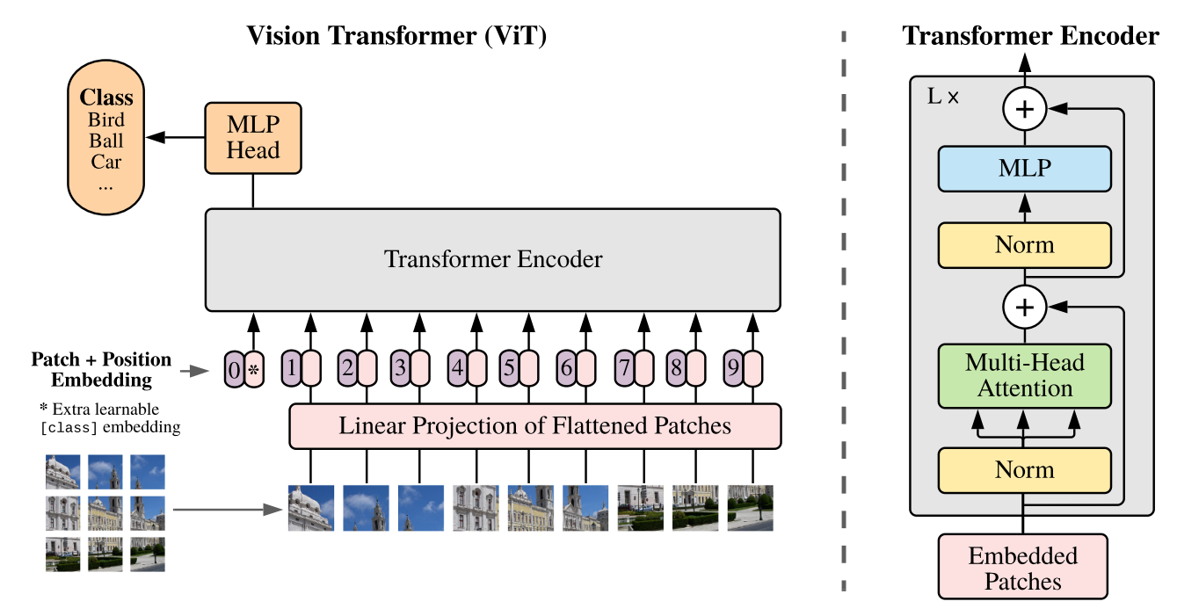
Vision Transformer (ViT) ^{[2]}
First work to show how Transformers can altogether replace standard convolutions in deep networks on large-scale computer vision datasets.
Apply the original Transformer model (with minimal changes compared to the NLP) on a sequence of image ’patches’.
Pre-trained model required.
Framework:
1. Split images into fixed-size patches;
2. Linearly embed patches,
add position embeddings;
3. Feed to a standard Transformer Encoder;
4. Add an extra learnable token for classification.
[2] Dosovitskiy, Alexey, et al. "An image is worth 16x16 words: Transformers for image recognition at scale." arXiv preprint arXiv:2010.11929 (2020).
Notes:
We split an image into fixed-size patches, linearly embed each of them, add position embeddings, and feed the resulting sequence of vectors to a standard Transformer encoder. In order to perform classification, we use the standard approach of adding an extra learnable “classification token” to the sequence. The

Slide 5
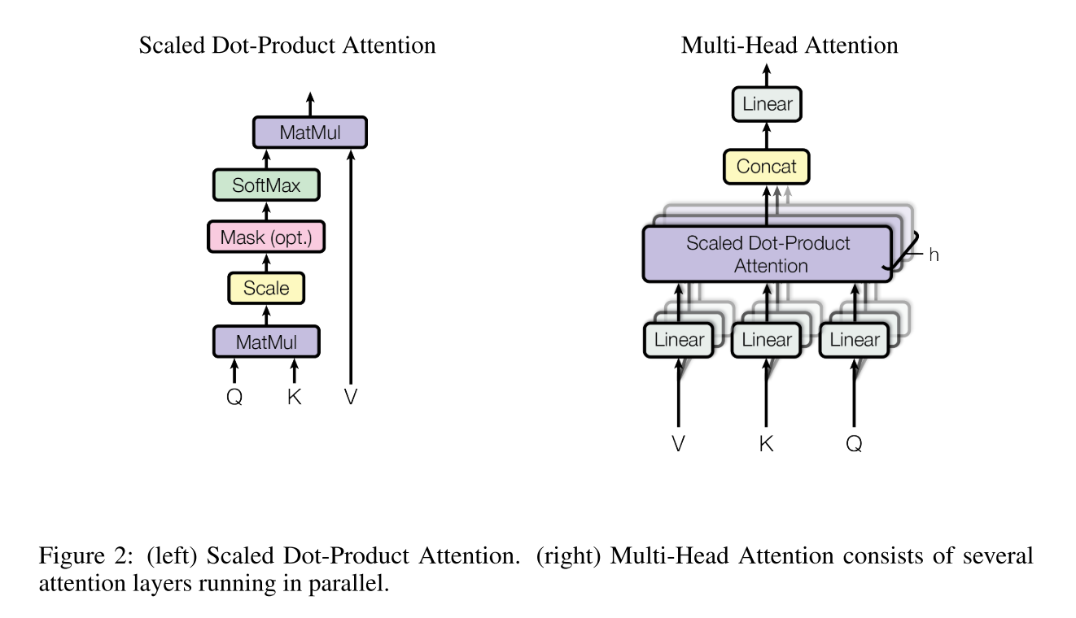
Vision Transformer (ViT) ^{[2]}
First work to show how Transformers can altogether replace standard convolutions in deep networks on large-scale computer vision datasets.
Apply the original Transformer model (with minimal changes compared to the NLP) on a sequence of image ’patches’.
Pre-trained model required.
Framework:
1. Split images into fixed-size patches;
2. Linearly embed patches,
add position embeddings;
3. Feed to a standard Transformer Encoder;
4. Add an extra learnable token for classification.
[2] Dosovitskiy, Alexey, et al. "An image is worth 16x16 words: Transformers for image recognition at scale." arXiv preprint arXiv:2010.11929 (2020).

Slide 6
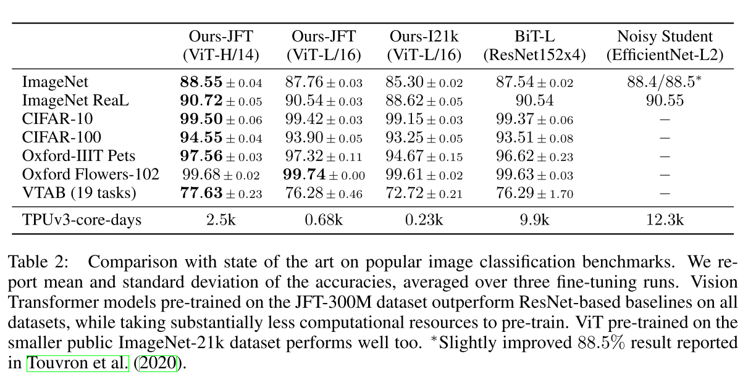
Vision Transformer (ViT) ^{[2]}
TPUv3-core-days: training time for pre-trained model

Slide 7
Convolutional Vision Transformer (CvT) ^{[3]}
Improve ViT performance and efficiency by introducing a hierarchy of Transformers containing a new convolutional token embedding, and a convolutional Transformer block leveraging a convolutional projection.
Introduce desirable properties of CNNs to the ViT architecture (i.e. shift, scale, and distortion invariance) while maintaining the merits of Transformers (i.e. dynamic attention, global context, and better generalization)
[3] Wu, Haiping, et al. "Cvt: Introducing convolutions to vision transformers." arXiv preprint arXiv:2103.15808 (2021).

Slide 8
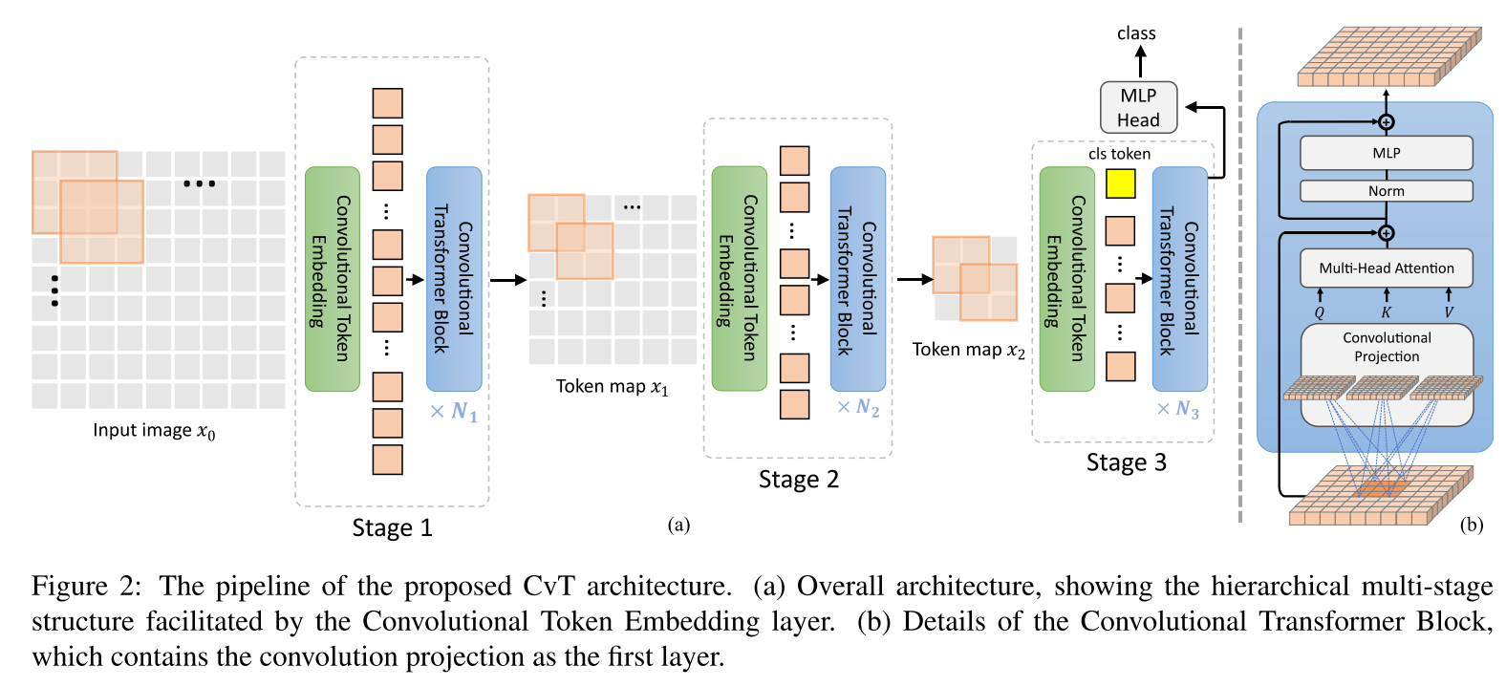
Convolutional Vision Transformer (CvT) ^{[3]}
[3] Wu, Haiping, et al. "Cvt: Introducing convolutions to vision transformers." arXiv preprint arXiv:2103.15808 (2021).
Notes:
Replace linear embedding with convolutional embeddings. The Convolutional Token Embedding layer allows us to adjust the token feature dimension and the number of tokens at each stage by varying parameters of the convolution operation.
This gives the tokens the ability to represent increasingly complex visual patterns over in- creasingly larger spatial footprints, similar to feature layers of CNNs.

Slide 9
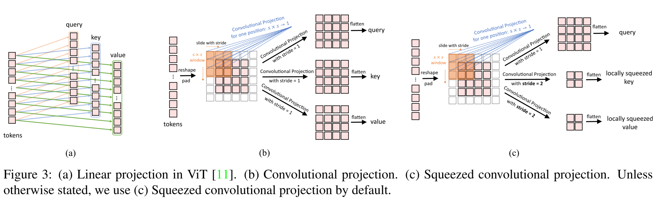
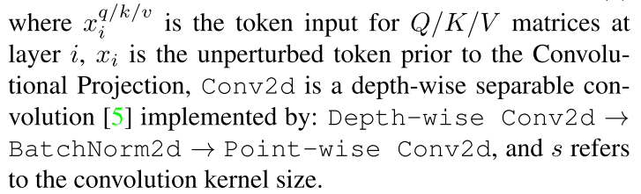

Convolutional Vision Transformer (CvT) ^{[3]}
Notes:
tokens are first reshaped into a 2D token map. Next, a Convolutional Projection is implemented using a convolution layer with kernel size s. Finally, the projected tokens are flattened into 1D for subsequent process.
The resulting new Transformer Block with the Convolutional Projection layer is a generalization of the original Transformer Block design. The original position-wise linear projection layer could be trivially implemented using a convolution layer with kernel size of 1 × 1.

Slide 10
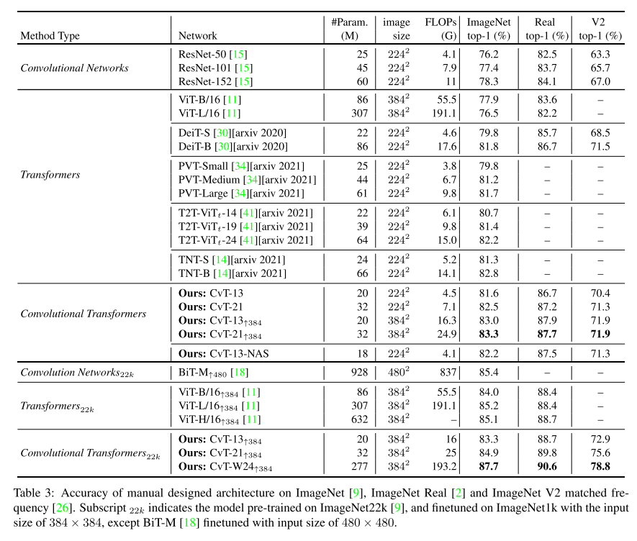
Results
Notes:
tokens are first reshaped into a 2D token map. Next, a Convolutional Projection is implemented using a depth-wise separable convolution layer with kernel size s. Finally, the projected tokens are flattened into 1D for subsequent process.
The resulting new Transformer Block with the Convolutional Projection layer is a generalization of the original Transformer Block design. The original position-wise linear projection layer could be trivially implemented using a convolution layer with kernel size of 1 × 1.

Slide 11
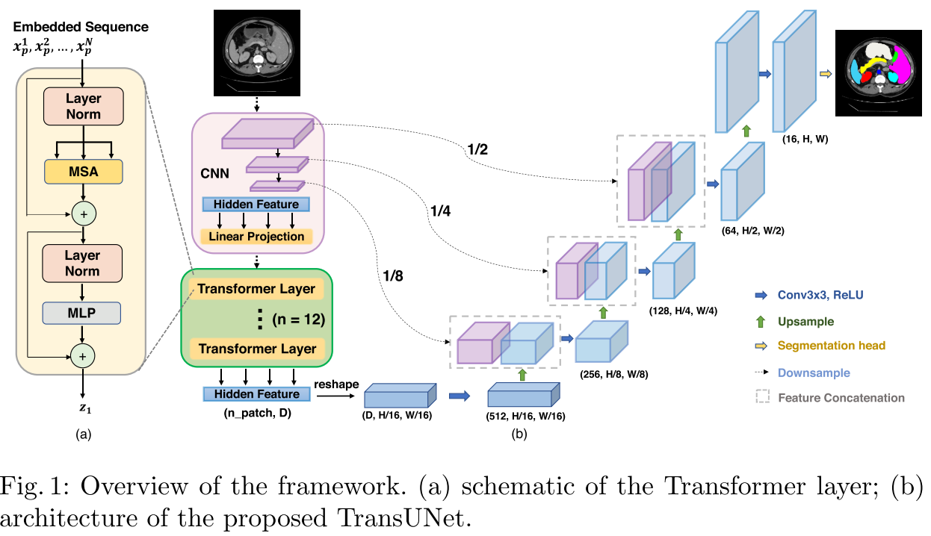
TransUNet ^{[4]}
First work to apply ViT to Medical Segmentation tasks.
Replicate ViT as the encoder block of a standard UNet.
CNN architecture (ResNet-50) guarantees its basic performance.
[4] Chen, Jieneng, et al. "Transunet: Transformers make strong encoders for medical image segmentation." arXiv preprint arXiv:2102.04306 (2021).

Slide 12
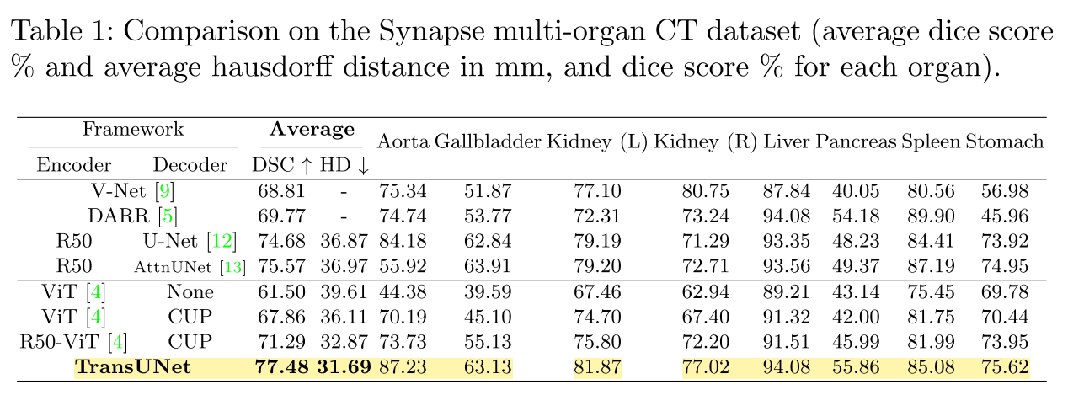
Results

Slide 13
Results
DICE
 | Average | Aorta | Gallbladder | Kidney L | Kidney R | Liver | Pancreas | Spleen | Stomach
Reported | 77.48 | 87.23 | 63.13 | 81.87 | 77.02 | 94.08 | 55.86 | 85.08 | 75.62
Reproducted | 76.42 | 87.25 | 55.69 | 81.93 | 76.13 | 94.44 | 55.75 | 85.19 | 75.02
No_pretrained | 76.21 | 85.34 | 63.12 | 81.25 | 80.38 | 93.07 | 51.09 | 84.22 | 71.19
HD95
 | Average | Aorta | Gallbladder | Kidney L | Kidney R | Liver | Pancreas | Spleen | Stomach
Reported | 31.69 | - | - | - | - | - | - | - | -
Reproducted | 30.5 | 12.7 | 26.58 | 62.98 | 22.19 | 33.11 | 14.21 | 52.19 | 75.02
No_pretrained | 22.87 | 5.04 | 19.94 | 4.58 | 61.77 | 33.48 | 14.37 | 24.74 | 19.04
Notes:
The average performance of my replication is almost the same as the paper reported.
I also removed the pretrain model to test if the performance drops. We can see how the ResNet guarantees its basic performance.
However, the performance on small organs varies greatly, which is a inherit shortage of transformer that cannot p.

Slide 14
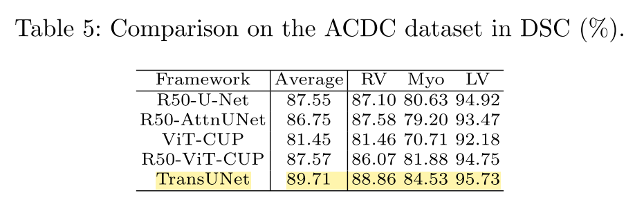
Results
TransUNet Deep Layer Aggregation
TransUNet Deep Layer Aggregation
DICE: | DICE:
es: | es:
LVM: 0.892566 | LVM: 0.900267
LVC: 0.906961 | LVC: 0.904056
RV: 0.842610 | RV: 0.883432
complete: 0.938378 | complete: 0.950034
ed: | ed:
LVM: 0.879912 | LVM: 0.891204
LVC: 0.958131 | LVC: 0.962670
RV: 0.924530 | RV: 0.934740
complete: 0.961707 | complete: 0.966348
combined: | combined:
LVM: 0.886239 | LVM: 0.895735
LVC: 0.932546 | LVC: 0.933363
RV: 0.883570 | RV: 0.909086
complete: 0.950042 | complete: 0.958191
Hausdorff: | Hausdorff:
es: | es:
LVM: 9.902183 | LVM: 10.200614
LVC: 9.115721 | LVC: 9.422168
RV: 15.112847 | RV: 14.321127
complete: 12.736465 | complete: 10.743962
ed: | ed:
LVM: 8.635107 | LVM: 8.931788
LVC: 6.868413 | LVC: 7.569595
RV: 14.685259 | RV: 14.223437
complete: 10.868176 | complete: 11.572251
combined: | combined:
LVM: 9.268645 | LVM: 9.566201
LVC: 7.992067 | LVC: 8.495881
RV: 14.899053 | RV: 14.272282
complete: 11.802321 | complete: 11.158107

Slide 15
Future directions
Employ convolutional token embeddings and projections to cardiac segmentation tasks.
Cross attention: combine long- and short-axis information for 3D cardiac segmentation.
Fusion mode of CNN & attention blocks to improve Transformer performance in medical segmentation.

Slide 16
Thanks.

